Slide 2
Digital technology
TK1104-1 22H
Lecturer: Toktam Ramezanifarkhani
Toktam.Ramezanifarkhani@kristiania.no
Toktamr@ifi.uio.no

Slide 3

The Binary Numbering Systems

Slide 4
Last week
Introduction
Computer and its main components
a man-made device that receives data in a form, processes these and produces new (and more useful) information built on the original data
What is this device?
What is in there?
Computer assembly
Laptop ...

Slide 5
This Session
Data representation
Number systems: decimal, binary, hexadecimal (octal)
Simple calculations
Precision and negative numbers
(Coding / decoding (begins, we will have more))
EXERCISE in this topic is important, calculate tasks to understand!

Slide 6
The point!
The point is not in itself to count…
We want to understand computers better…
Computers are calculators
Binary arithmetic is thus «computer psychology»

Slide 7
Types of data / information
A (general) computer processes 5 main types of information
Numeric
Number calculations
Grade-based (alphanumeric)
Text manipulation
Visual
Pictures
Audio
Sound
Instructions
Internal orders to the computer (CPU) about what to do

Slide 8
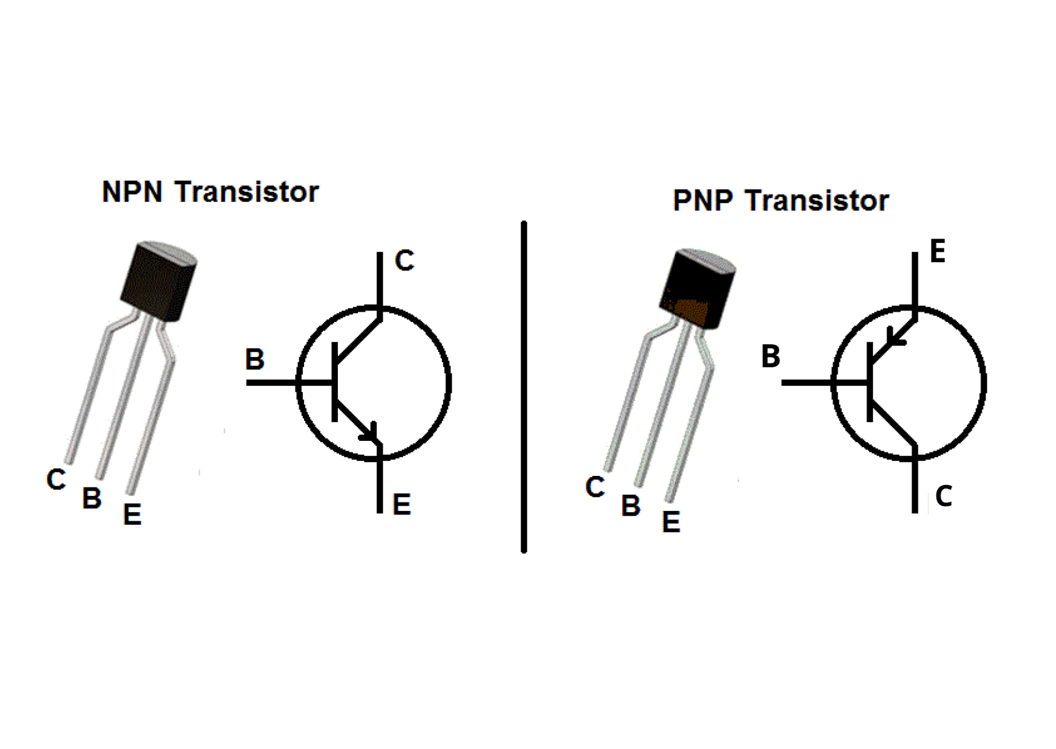
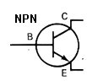
Representation in a computer
Today's digital computers use binary numbers
Needs only two digits: 0 and 1
This provides the possibility of simple logic circuits
At the same time all kinds of information can be represented in this way
Notes:
negative-positive-negative transistor is denoted by the abbreviation NPN
LED LET

Slide 9

Example
Im not coming
I’ll come by myself (see you!)
How many messages can we send and receive by x bits(lamps)?
I’ll come a little later (wait for me)
Im coming right now

Slide 10
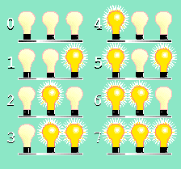
Binary number representation
With 3 lamps we can represent 2³ = 8 combinations of on / off
With Off = 0 and On = 1 we get
0 = 000 4 = 100
1 = 001 5 = 101
2 = 010 6 = 110
3 = 011 7 = 111
This can be extended to use more lamps
(transistors), e.g. 8, 16, 32, 64, ....

Slide 11
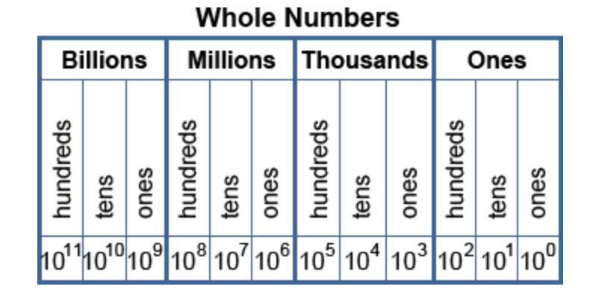
Decimal numeral system or base-10
Each column indicates the number of boxes with the capacity of base^{column}
the decimal numeral system or base-10 positional numeral system:
a system for expressing numerals such that the position of the digit indicates the power of 10 that the digit is multiplied by to determine its value.
For example, the integer 10 has a 1 in the tens place and a 0 in the ones place.

Slide 12
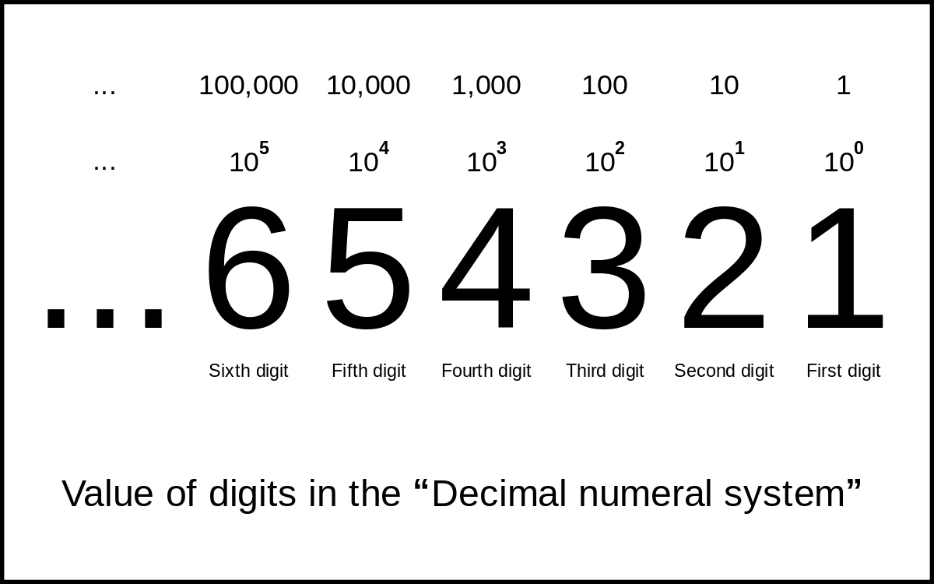
Example

Slide 13
The Binary Numbering Systems
A numbering system (base) is a way to represent numbers, base k
We denote the base by adding k as a subscript at the end of the number as in 1234₅ for base 5 (we can omit 10 if in base 10)
Decimal is base 10, binary is base 2
We use 10 because of 10 fingers, but are interested in 2 (also 8 and 16) because computers store and process information in a digital (on/off) way
1 binary digit is a bit
In 1 bit, we store a 0 or a 1
This doesn’t give us much meaning, just 1/0, yes/no, true/false
We group 8 bits together to store 1 byte
00000000 to 11111111
In 1 byte, we can store a number from 0 to 255 or a character (e.g., ‘a’, ‘$’, ‘8’, ‘ ’)

Slide 14
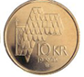
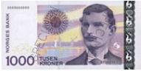
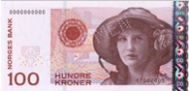
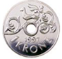
Decimal numbers - position numbers
The "regular" (decimal) number system uses 10 digits / symbols (0 - 9), while the binary system only uses 2 digits / symbols (0-1).
However, the principles behind the binary number system are the same as for the decimal system
The position of a digit in a number determines what value the digit represents ("weight").
5372

Slide 15
Interpreting Numbers
The base tells us how to interpret each digit
The column that the digit is in represents the value base^{column}
the rightmost column is always column 0
Example:
5372 in base 10 has
5 in the 10³ column (1,000)
3 in the 10² column (100)
7 in the 10¹ column (10)
2 in the 10⁰ column (1)
To convert from some base k to base 10, apply this formula
abcde_{k} = a * k⁴ + b * k³ + c * k² + d * k¹ + e * k⁰
a, b, c, d, e are the digits, k⁰ is always 1
To convert binary to decimal, the values of k⁰, k¹, k², etc are powers of 2 (1, 2, 4, 8, 16, 32, …)

Slide 16

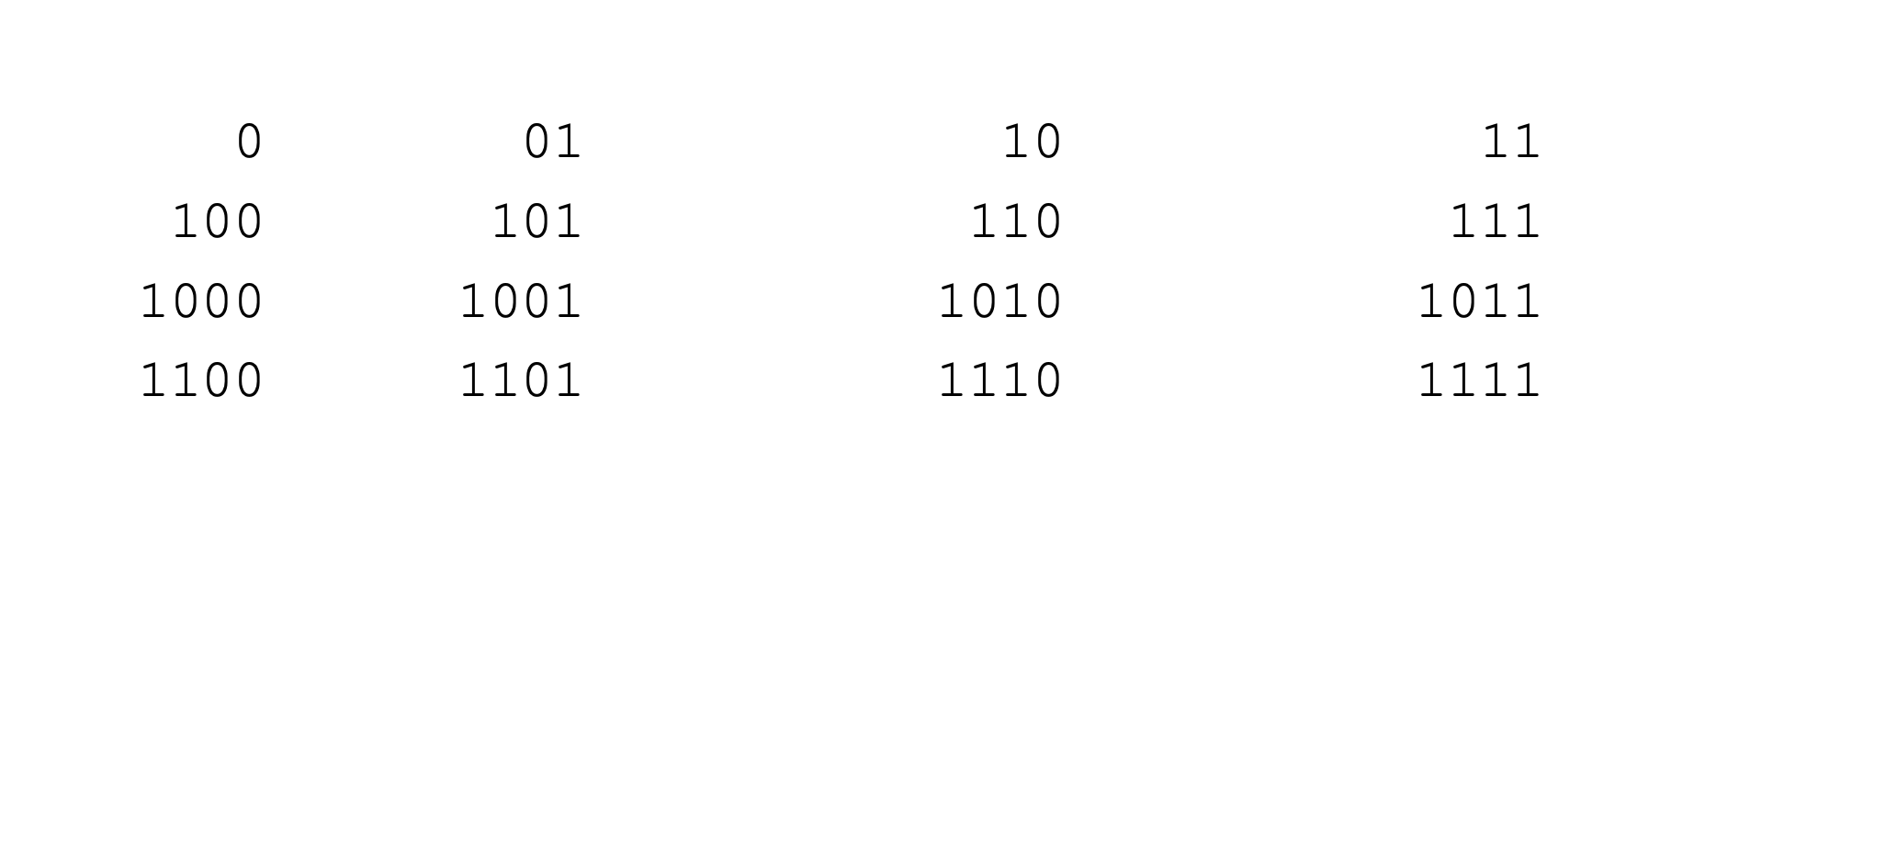
Counting with binary numbers

Slide 17
There are 10 types of people in the world,
those who can binary and those who can not.

Slide 18
Tutorials
Binary 1 - Converting to and from Denary (decimal.)
https://www.youtube.com/watch?v=cJNm938Xwao&list=PLTd6ceoshprfijQztP-IKey4OV7nkr_va&t=129s
(https://www.youtube.com/watch?v=cJNm938Xwao&list=PLTd6ceoshprcpen2Jvs_JiuvWvqIAkzea)

Slide 19
Conversion from binary to decimal
9
4
1
0
8
6
1101010011
2⁰ = 1
2¹ = 2
2² = 4
2³ = 8
2⁴ = 16
2⁵ = 32
2⁶ = 64
2⁷ = 128
2⁸ = 256
2⁹ = 512
2¹⁰ = 1024
512
256
64
16
2
1
1101010011 =
1*2⁹+1*2⁸+0*2⁷+1*2⁶+0*2⁵+1*2⁴+0*2³+0*2²+1*2¹+1*2⁰
= 512 + 256 + 64 + 16 + 2 + 1
= 851
Careful! Initial zeros in 16 bit precision are missing here!!
0000 0011 0101 0011

Slide 20
Binary to Decimal Conversion
Multiply each binary bit by its column value
In binary, our columns are (from right to left)
2⁰ = 1
2¹ = 2
2² = 4
2³ = 8
2⁴ = 16
2⁵ = 32
Etc
10110 = 1 * 2⁴ + 0 * 2³ + 1 * 2² + 1 * 2¹ + 0 * 2⁰ = 16 + 0 + 4 + 2 + 0 = 22
1100001 = 1 * 2⁶ + 1 * 2⁵ + 0 * 2⁴ + 0 * 2³ + 0 * 2² + 0 * 2¹ + 1 * 2⁰ = 64 + 32 + 0 + 0 + 0 + 0 + 1 = 97

Slide 21
Simplifying Conversion in Binary
Our digits will either be 0 or 1
0 * anything is 0
1 * anything is that thing
Just add together the powers of 2 whose corresponding digits are 1 and ignore any digits of 0
10110 = 2⁴ + 2² + 2¹ = 16 + 4 + 2 = 22
1100001 = 2⁶ + 2⁵ + 2⁰ = 64 + 32 + 1 = 97

Slide 22
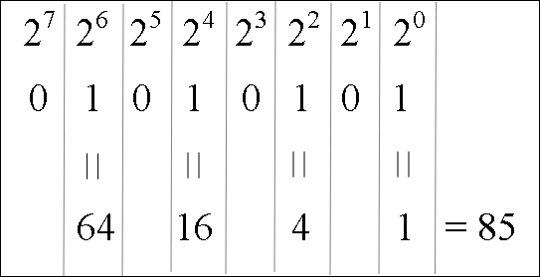
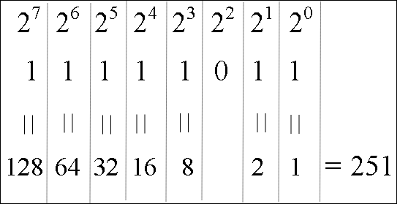
Examples of Binary to Decimal Conversion
11010110 =
128 + 64 + 16 + 4 + 2
= 214
10001011 = 128 + 8 + 2 + 1
= 139
11111111 = 128 + 64 + 32 +
16 + 8 + 4 + 2 + 1
= 255
00110011 = 32 + 16 +
2 + 1
= 51

Slide 23
Converting from Decimal to Binary
The typical approach is to continually divide the decimal value by 2, recording the quotient and the remainder until the quotient is 0
The binary number is the group of remainder bits written in opposite order
Convert 19 to binary
19 / 2 = 9 remainder 1
9 / 2 = 4 remainder 1
4 / 2 = 2 remainder 0
2 / 2 = 1 remainder 0
1 / 2 = 0 remainder 1
19 = 10011₂
Record the remainders
and then write them
in opposite order

Slide 24
Examples
Convert 200 to binary
200 / 2 = 100 r 0
100 / 2 = 50 r 0
50 / 2 = 25 r 0
25 / 2 = 12 r 1
12 / 2 = 6 r 0
6 / 2 = 3 r 0
3 / 2 = 1 r 1
1 / 2 = 0 r 1
200 = (11001000)₂
Convert 16 to binary
16 / 2 = 8 r 0
8 / 2 = 4 r 0
4 / 2 = 2 r 0
2 / 2 = 1 r 0
1 /2 = 0 r 1
16 = 10000
Convert 21 to binary
21 / 2 = 10 r 1
10 / 2 = 5 r 0
5 / 2 = 2 r 1
2 / 2 = 1 r 0
1 / 2 = 0 r 1
21 = 10101
Convert 122 to binary
122 / 2 = 61 r 0
61 / 2 = 30 r 1
30 / 2 = 15 r 0
15 / 2 = 7 r 1
7 / 2 = 3 r 1
3 / 2 = 1 r 1
1 / 2 = 0 r 1
122 = 1111010

Slide 25
Another Technique
Recall to convert from binary to decimal, we add the powers of 2 for each digit that is a 1
To convert from decimal to binary, we can subtract all of the powers of 2 that make up the number and record 1s in corresponding columns
Example
19 = 16 + 2 + 1
So there is a 16 (2⁴), a 2 (2¹) and 1 (2⁰)
Put 1s in the 4th, 1st, and 0th columns:
19 = 10011₂
2⁰ = 1
2¹ = 2
2² = 4
2³ = 8
2⁴ = 16
2⁵ = 32
…

Slide 26
Conversion from decimal to binary – Example (Another Technique)
851 =
512 + 339 =
2⁹ + 339
2⁰ = 1
2¹ = 2
2² = 4
2³ = 8
2⁴ = 16
2⁵ = 32
2⁶ = 64
2⁷ = 128
2⁸ = 256
2⁹ = 512
2¹⁰ = 1024
339 =
256 + 83 =
2⁸ + 83
83 =
64 + 19 =
2⁶ + 19
19 =
16 + 3 =
2⁴ + 3
3 =
2 + 1 =
2¹ + 1
1 =
2⁰
851 = 2⁹ + 2⁸ + 2⁶ + 2⁴ + 2¹ + 2⁰
851 = 1*2⁹ + 1*2⁸ +0*2⁷+ 1*2⁶ +0*2⁵+1*2⁴ +0*2³ +0*2²+1*2¹ + 1*2⁰
851₁₀ = 0000 0011 0101 0011₂

Slide 27
More Examples
Convert 122 to binary
Largest power of 2 <= 122 = 64 leaving 122 – 64 = 58
Largest power of 2 <= 58 = 32 leaving 58 – 32 = 26
Largest power of 2 <= 26 = 16 leaving 26 – 16 = 10
Largest power of 2 <= 10 = 8 leaving 10 – 8 = 2
Largest power of 2 <= 2 = 2 leaving 0
Done
122 = 64 + 32 + 16 + 8 + 2 = 1111010
More examples:
555 = 512 + 32 + 8 + 2 + 1 = 1000101011
200 = 128 + 64 + 8 = 11001000
199 = 128 + 64 + 4 + 2 + 1 = 11000111
31 = 16 + 8 + 4 + 2 + 1 = 11111
60 = 32 + 16 + 8 + 4 = 111100
1000 = 512 + 256 + 128 + 64 + 32 + 8 = 1111101000
20 = 16 + 4 = 10100

Slide 28
Number of Bits
Notice in our previous examples that for 555 we needed 10 bits and for 25 we only needed 5 bits
The number of bits available tells us the range of values we can store
In 8 bits (1 byte), we can store between 0 and 255
00000000 = 0
11111111 = 255 (128 + 64 + 32 + 16 + 8 + 4 + 2 + 1)
In n bits, you can store a number from 0 to 2^{n}-1
For 8 bits, 2⁸ = 256, the largest value that can be stored in 8 bits is 255
What about 5 bits?
What about 3 bits?
Lets take base k and raise it to power of the column index i, e.g. K^{i}
Like 2 to the 3rd power = 2³
We can have this exponential equation:
K raised to power i equals n: K^{i}=n the exponent I is the logarithm of n
Then log^{n}_{k}=i log base k of a number n equals p the power
i= log^{n}_{x}/ log^{k}_{x.}
Notes:
https://www.youtube.com/watch?v=zzu2POfYv0Y

Slide 29
Number of Bits (cont.) How many bits we need to represent a number?
N=1101?
4 bits we need
Lets assume we take base k and raise it to power of the column index i, e.g. K^{i}
Like 2 to the 3rd power = 2³
To calculate the number of digits we need to represent n:
We have an exponential equation when N equals K raised to power i
K^{i}=n
the exponent I is the logarithm of n: log^{n}_{k}=i (log base k of the number n equls i the power)
i= log^{n}_{x}/ log^{k}_{x.}

Slide 30
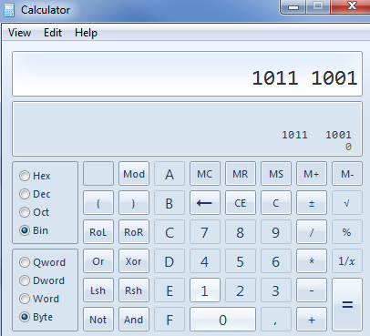
PRECISION
In computers, everything is stored either in RAM(«memory»),in registers («memory») on the CPU or other equipment.
These have addresses/names
Both in memory and on the CPU are smallest addressable device a Byte
It is not possible to save a bit, the minimum is 8!
Microsoft and others operates with the devices:
Byte: 8 bit
Word: 16 bit
Dword: 32 bit
Qword: 64 bit

Slide 31
Summary until this point

Slide 32
Decimal numeral system or base-10
Each column indicates the number of boxes with the capacity of base^{column}
the decimal numeral system or base-10 positional numeral system:
a system for expressing numerals such that the position of the digit indicates the power of 10 that the digit is multiplied by to determine its value.
For example, the integer 10 has a 1 in the tens place and a 0 in the ones place.

Slide 33
Decimal numbers - position numbers
The "regular" (decimal) number system uses 10 digits / symbols (0 - 9), while the binary system only uses 2 digits / symbols (0-1).
However, the principles behind the binary number system are the same as for the decimal system
The position of a digit in a number determines what value the digit represents ("weight").
5372

Slide 34
Conversion from binary to decimal
9
4
1
0
8
6
1101010011
2⁰ = 1
2¹ = 2
2² = 4
2³ = 8
2⁴ = 16
2⁵ = 32
2⁶ = 64
2⁷ = 128
2⁸ = 256
2⁹ = 512
2¹⁰ = 1024
512
256
64
16
2
1
1101010011 =
1*2⁹+1*2⁸+0*2⁷+1*2⁶+0*2⁵+1*2⁴+0*2³+0*2²+1*2¹+1*2⁰
= 512 + 256 + 64 + 16 + 2 + 1
= 851
Careful! Initial zeros in 16 bit precision are missing here!!
0000 0011 0101 0011

Slide 35
Examples of Binary to Decimal Conversion
11010110 =
128 + 64 + 16 + 4 + 2
= 214
10001011 = 128 + 8 + 2 + 1
= 139
11111111 = 128 + 64 + 32 +
16 + 8 + 4 + 2 + 1
= 255
00110011 = 32 + 16 +
2 + 1
= 51

Slide 36
Converting from Decimal to Binary
The typical approach is to continually divide the decimal value by 2, recording the quotient and the remainder until the quotient is 0
The binary number is the group of remainder bits written in opposite order
Convert 19 to binary
19 / 2 = 9 remainder 1
9 / 2 = 4 remainder 1
4 / 2 = 2 remainder 0
2 / 2 = 1 remainder 0
1 / 2 = 0 remainder 1
19 = 10011₂
Record the remainders
and then write them
in opposite order

Slide 37
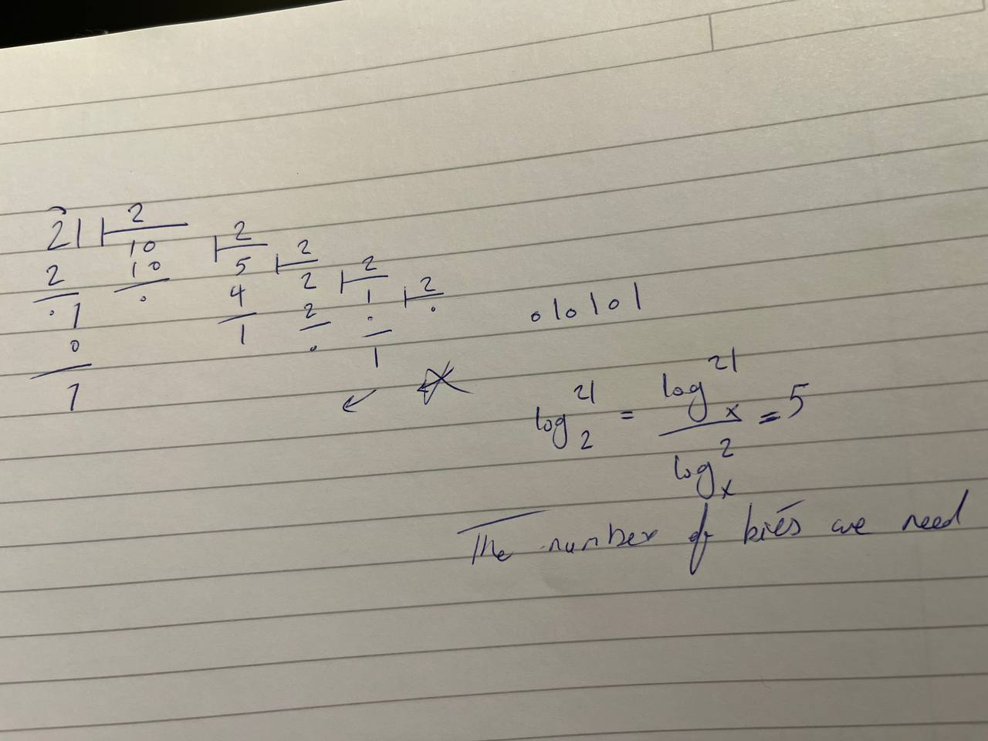
Example of Converting from Decimal to Binary
Converting 21 from Decimal to Binary:

Slide 38
Conversion from decimal to binary – Example (Another Technique)
851 =
512 + 339 =
2⁹ + 339
2⁰ = 1
2¹ = 2
2² = 4
2³ = 8
2⁴ = 16
2⁵ = 32
2⁶ = 64
2⁷ = 128
2⁸ = 256
2⁹ = 512
2¹⁰ = 1024
339 =
256 + 83 =
2⁸ + 83
83 =
64 + 19 =
2⁶ + 19
19 =
16 + 3 =
2⁴ + 3
3 =
2 + 1 =
2¹ + 1
1 =
2⁰
851 = 2⁹ + 2⁸ + 2⁶ + 2⁴ + 2¹ + 2⁰
851 = 1*2⁹ + 1*2⁸ +0*2⁷+ 1*2⁶ +0*2⁵+1*2⁴ +0*2³ +0*2²+1*2¹ + 1*2⁰
851₁₀ = 0000 0011 0101 0011₂

Slide 39
Example of Converting from Decimal to Binary
Converting 21 from Decimal to Binary (you can use this approach as well. It is your choice):
2⁰ = 1
2¹ = 2
2² = 4
2³ = 8
2⁴ = 16
2⁵ = 32
2⁶ = 64
2⁷ = 128
2⁸ = 256
2⁹ = 512
2¹⁰ = 1024
21=16+4+1
21= 2⁶+ 2²+ 2⁰
2⁴ | 2³ | 2² | 2¹ | 2⁰
1 | 0 | 1 | 0 | 1
16 |  | 4 |  | 1

Slide 40
Number of Bits (cont.) How many bits do we need to represent a number?
N=1101?
4 bits we need
Lets assume we take base k and raise it to power of the column index i, e.g. K^{i}
Like 2 to the 3rd power = 2³
To calculate the number of digits we need to represent n:
We have an exponential equation when N equals K raised to power i
K^{i}=n
the exponent I is the logarithm of n: log^{n}_{k}=i (log base k of the number n equls i the power)
i= log^{n}_{x}/ log^{k}_{x.}

Slide 41
Example - Number of Bits
How many bits(digits) we need to represent 555 in binary
We can have this exponential equation:
Assume that K raised to power i equals n:
K^{i}=n (2^{i}=555)
the exponent i is the logarithm of n:
log^{n}_{k}=i
(log⁵⁵⁵₂=i) log base k of a number n equls i the power
i= log^{n}_{x}/ log^{k}_{x.}
(i= log⁵⁵⁵_{x}/( log²_{x}))=10

Slide 42
PRECISION
In computers, everything is stored either in RAM(«memory»),in registers («memory») on the CPU or other equipment.
These have addresses/names
Both in memory and on the CPU are smallest addressable device a Byte
It is not possible to save a bit, the minimum is 8!
Microsoft and others operat with the devices:
Byte: 8 bit
Word: 16 bit
Dword: 32 bit
Qword: 64 bit

Slide 43
Negative and fractional numbers

Slide 44
Negative Numbers decimal to binary
To store negative numbers, we need a bit to indicate the sign
0 = positive, 1 = negative
Several representations for negative numbers, we use two’s complement, Precision (number of bits computer uses) must be determined
Positive numbers are the same as in our previous approach
Negative numbers need to be converted, three ways to do this:
1's complement: NOT (flip) all of the bits (1 becomes 0, 0 becomes 1)
2's complement: Add 1
Example: -57 in 8 bits
+57 = 32 + 16 + 8 + 1 = 00111001
-57 = NOT(00111001) + 1 = 11000110 + 1 = 11000111
decimal to binary First

Slide 45
Negative number: decimal to binary
+5=0000 0101
-5=?
1's complement 1111 1010
2's complement= 1's complement+1
1111 1011=-5
Just by changing the sign bit, the number will not be negative
Shortcut:
Starting from the right of the number
copy each bit until the first 1
flip all of the remaining bits
1s become 0s, 0s become 1s
decimal to binary Second

Slide 46
Examples - decimal to binary (all are 8 bits)
-57
+57 = 00111001
from the right, copy all digits through the first one:
-------1
Flip remaining bits (0011100)
1100011 1 = 11000111
-108
+108 = 01101100
from the right, copy all digits through the first one:
-----100
flip the rest of the bits (01101)
10010 100 = 10010100
-96
+96 = 01100000
from right, copy all bits through the first one:
--100000
flip rest of the bits (01)
10 100000 = 10100000
-5
+5 = 00000101
from right, copy all bits through the first one:
-------1
flip rest of the bits (0000010)
1111101 1 = 11111011

Slide 47
Negative number: convert binary to decimal
There are two ways: binary to decimal First
it is stated that a double complement has been used on it
you will first see if it is a positive or negative number
If the most significant bit (MSB) is 0 is the number positive,
if it is 1 the number is negative. (Here you must also make sure that you know the precision).
The approach:
The first bit corresponds to the number -128.
All the other bits can be considered positive, and thus we can add them with -128

Slide 48
Example of a Negative number: convert binary to decimal
There are two ways: binary to decimal First
The approach:
The first bit corresponds to the number -128.
All the other bits can be considered positive, and thus we can add them with -128
Example: Say we have the number 1010 0101 with 8 bit precision on 2’s complement. To convert:
Then we have to look at the number 8 places from the right, and decide if the number is negative or positive. We see that the ‘Sign’ bit is a 1, which means that the number is negative.
The first bit corresponds to the number -128.
All the other bits can be considered positive, and thus we can add them with -128 as follows:
1010 0101 = (-128) + 32 + 4 + 1 = -91

Slide 49
Examples: convert binary to decimal (cont.)
If the most significant bit had been 0 and it is 2’s complement, we would have got a completely different result:
0010 0101 = (0) + 32 + 4 + 1 = 37
And if we were to run the math without a 2's complement, the result is completely different:
1010 0101 = (128) + 32 + 4 + 1 = 165

Slide 50
Negative number: binary to decimal
There are two ways: binary to decimal, Second
Shortcut:
1111 1011=?₁₀
Find the first 10 from the left and keep the 1
1111 1011
-2³
Add the rest
-2³+2¹+2⁰
= -5

Slide 51
Negative number: decimal to binary explains the shortcut- binary to decimal
decimal to binary: Third
Using shortcut to convert binary to decimal, we can learn how to do opposite direction
Reminder:
you will first see if it is a positive or negative number
If the most significant bit (MSB) is 0 is the number positive,
if it is 1 the number is negative. (Here you must also make sure that you know the precision).
The approach to convert decimal negative number to binary
when the number is negative, then we know that MSB must be 1,
Then we now have to find out which one of the other bits should be 1 before giving the correct answer, i.e.
"What do we have to plus -128 to get the correct answer?" .

Slide 52
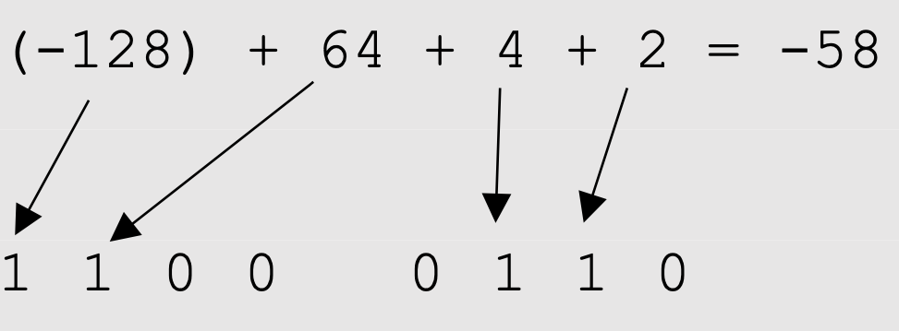
Negative number: decimal to binary explains the shortcut- binary to decimal
In the Lab
decimal to binary: Third
The approach to convert decimal negative number to binary
when the number is negative, then we know that MSB must be 1,
Then we now have to find out which one of the other bits should be 1 before giving the correct answer, i.e.
"What do we have to plus -128 to get the correct answer?" .
To convert a decimal number to binary, and it is stated that a double complement has been used on it,
Example: What is -58 in binary with 8-bit precision and 2's complement?
(-128) + x = -58, x=70
70 - 64 = 6
6 – 4 = 2
2 – 2 = 0
Now we have figured out which bits should be positive (1 and not 0), these are 64, 4 and 2.

Slide 53
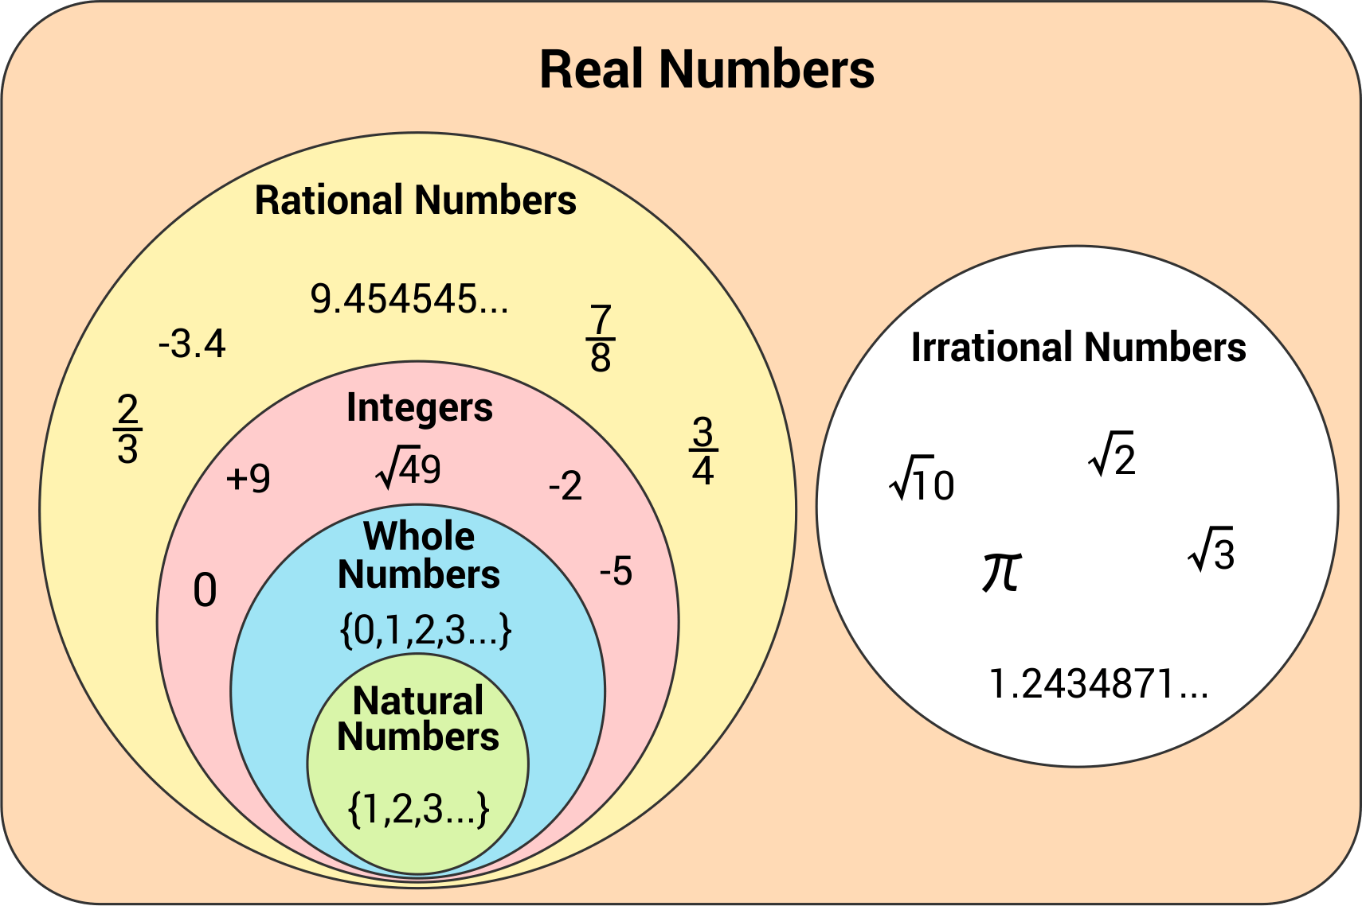
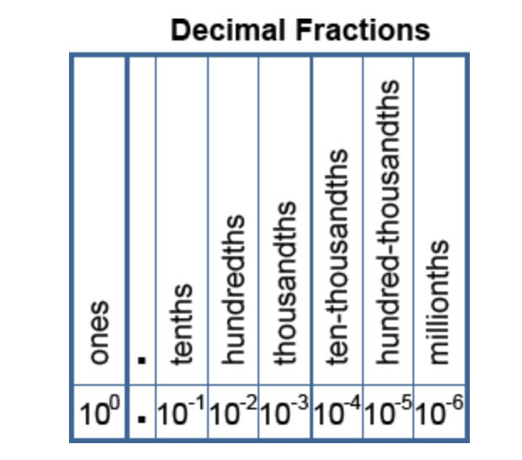
Decimal Fractions

Slide 54
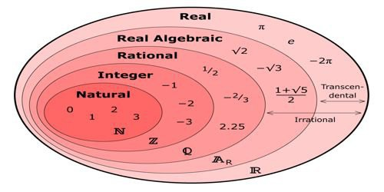
Real (Fractional) Numbers
Extend our powers of two to the right of the decimal point using negative powers of 2
101.1 = 2² + 2⁰ + 2⁻¹
What is 2⁻¹? 1/2¹
2⁻² = 1/2² = 1/4, 2⁻³ = 1/2³ = 1/8
10110.101 = 16 + 4 + 2 + 1/2 + 1/8 = 22 5/8 = 22.625
How do we represent the decimal point?
We use a floating point representation, like scientific notation, but in binary where we store 3 integer numbers, a sign bit (1 = negative, 0 = positive), the mantissa (the number without a decimal point) and the location of the decimal point as an exponent
1011011.1 = .10110111 * 2^7
Mantissa = 10110111
Exponent = 00111 (7, the exponent)
Sign = 0
further details are covered in the text, but omitted here

Slide 55
Examples

Slide 56





















How many objects do we have? (in what numbering system?)
Decimal: we divide objects by 10
31

Slide 57
How many objects do we have? (in what numbering system?)
Binary : we divide objects by 2
 | 2³ | 2² | 2¹ | 2⁰
 |  |  |  | 1
value | 8 | 4 | 2 | 1
21 /2 is 10 remainder 1

Slide 58
How many objects do we have? (in what numbering system?)
Binary : we divide objects by 2
 | 2³ | 2² | 2¹ | 2⁰
 |  |  | 0 | 1
value | 8 | 4 | 2 | 1
10(obj with size 2) /2 is 5 (obj with size 2) remainder 0 (obj with size 2)

Slide 59
How many objects do we have? (in what numbering system?)
Binary : we divide objects by 2
 | 2³ | 2² | 2¹ | 2⁰
 |  |  | 0 | 1
value | 8 | 4 | 2 | 1
5 /2 is 2 remainder 1

Slide 60
How many objects do we have? (in what numbering system?)
Binary : we divide objects by 2
 | 2³ | 2² | 2¹ | 2⁰
 |  | 1 | 0 | 1
value | 8 | 4 | 2 | 1
5 /2 is 2 remainder 1
We will have 5 objects with size 4

Slide 61
How many objects do we have? (in what numbering system?)
Binary : we divide objects by 2
 | 2³ | 2² | 2¹ | 2⁰
 |  | 1 | 0 | 1
value | 8 | 4 | 2 | 1
5(obj with size 4) /2 is 2(objects with size 4) remainder 1 (objects with size 4)

Slide 62
How many objects do we have? (in what numbering system?)
Binary : we divide objects by 2
 | 2³ | 2² | 2¹ | 2⁰
 | 0 | 1 | 0 | 1
value | 8 | 4 | 2 | 1
2(obj with size 8) /2 is 1(objects with size 8) remainder 0 (objects with size 8)

Slide 63
How many objects do we have? (in what numbering system?)
Binary : we divide objects by 2
2⁴ | 2³ | 2² | 2¹ | 2⁰
1 | 0 | 1 | 0 | 1
value 16 | 8 | 4 | 2 | 1
1(obj with size 16) /2 is 0(objects with size 16) remainder 1 (objects with size 16)

Slide 64
Applications

Slide 65
Character Representations
We need to invent a representation to store letters of the alphabet (there is no natural way)
Need to differentiate between upper and lower case letters – so we need at least 52 representations
We will want to also represent punctuation marks
Also digits (phone numbers use numbers but are not stored numerically)
3 character codes have been developed
EBCDIC – used only IBM mainframes
ASCII – the most common code, 7 bits – 128 different characters (add a 0 to the front to make it 8 bits or 1 byte per character)
Unicode – expands ASCII to 16 bits to represent over 65,000 characters

Slide 66
Hexadecimal number
Uses 16 as a base
Must then invent 6 "new" digits
A₁₆=10, B₁₆=11, C₁₆=12, D₁₆=13, E₁₆=14, F₁₆=15
0, 1, 2, 3, 4, 5, 6, 7, 8, 9, A, B, C, D, E, F
11₁₆ = 1*16 + 1*1 = 17₁₀, 0A4C₁₆ = 0*16³ + 10*16² + 4*16¹ + 12*16⁰ 0*4096 + 10*256 + 4*16 + 12*1 = 2636₁₀
Translates from binary to hex by grouping 4 and 4 binary numbers together ("nibbler")
1010 0011 1001 1111₂ =0xA39F₁₆
1010₂ = A₁₆, 0011₂ = 3₁₆, 1001₂ = 9₁₆, 1111₂ = F₁₆

Slide 67
Why Hex?
Fewer digits–USED TO WRITE BINARY NUMBERS MORE COMPACT
Noted in Java and many other contexts with prefix 0x
Example: 0x7F = 127 = 0b0111 1111
It’s so easy to calculate wrong with Hex,
so we prefer to go binary!

Slide 68
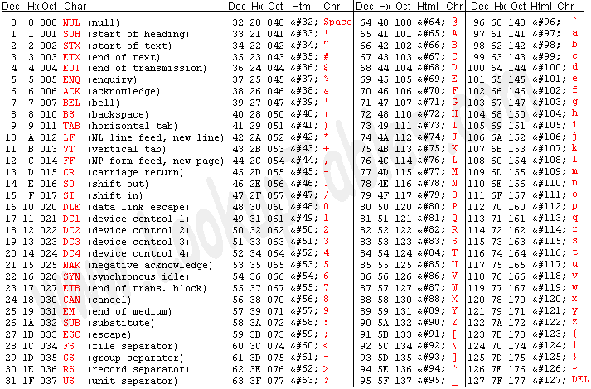
ASCII (7 bit)
A tool
HextEdit

Slide 69
ASCII (notice!)
”A” = 0x41 -> 0100 0001 ”a” = 0x61 -> 0110 0001
A little difference between uppercase and lowercase letters
The numbers are coded with: 0x30-0x39
Spaces are 0x20
More about this and other formats in the next lecture

Slide 70
Example
To store the word “Hello”
H = 72 = 01001000
e = 101 = 01100101
l = 108 = 01101100
l = 108 = 01101100
o = 111 = 01101111
Hello = 01001000 01100101 01101100 01101100 01101111
How much storage space is required for the string
R U 4 Luv?
10 bytes (5 letters, 3 spaces, 1 digit, 1 punctuation mark)
The ‘U’ and ‘u’ are represented using different values
‘U’ = 01010101
‘u’ = 01110101
The only difference between an upper and lower case letter is the 3rd bit from the left
upper case = 0, lower case = 1

Slide 71
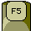


Interpretation of binary codes (a few)
 | 0011 1110 | 0010 0000 | 0111 0010 | 0011 0111
(hexadesimal) | 0x3E | 0x20 | 0x72 | 0x37
32-bit integer | 1 042 313 783
16-bit integer | 15 904 |  | 29 239
32 bit floating point number | 0.156686
BCD | Impossible! | 20 | 72 | 37
IPv4-address | 62.32.114.55
ASCII | > | space | r | 7
Scankode(USB) | F5 | 3 # | F23 | : .
UTF-16 | 㸠 |  | 爷
JVM bytecode | istore_3 | lstore_2 | frem | lstore
X86 code | DS: | AND | JNO | AAA

Slide 72
Summary to this point

Slide 73
Positional Numeral System (cont.)
Opposite direction:
To show a number m in binary we need x bits such that
2^{x}=m
X= log^{m}₂
By 1 bits:
we can show 0 and 1,
that are all numbers in [0,…,1],
or refer to 2 objects
By 2 bits:
we can show 00 and 01, 10, 11,
that are all numbers in [0,…,3],
or refer to 4 objects
By 3 bits:
we can show 000, 001, 010, 011,100, 101,110,111,
that are all numbers in [0,…,7],
or refer to 8 objects
By n bits:
we can show all numbers in [0,… ,2^{n}-1], or refer to 2^{n} objects

Slide 74
For small numbers
2⁰ = 1
2¹ = 2
2² = 4
2³ = 8
2⁴ = 16
2⁵ = 32
2⁶ = 64
2⁷ = 128
2⁸ = 256
2⁹ = 512
2¹⁰ = 1024
2¹¹ = 2048
2¹² = 4096
2¹³ = 8192
2¹⁴ = 16384
How many bits do you need to show 3000 or any number in (0 … 3000)
What about 7500?
What about 15990?

Slide 75
Positional Numeral System
 |  |  |  | Etc. | Second Digit | First Digit
10⁶ | 10⁵ | 10⁴ | 10³ | 10² | 10¹ | 10⁰ | Base 10 Each digitsbelongs to (0…9)
2⁶ | 2⁵ | 2⁴ | 2³ | 2² | 2¹ | 2⁰ | Base 2 (0…1)
16⁶ | 16⁵ | 16⁴ | 16³ | 16² | 16¹ | 16⁰ | Base 16 (0…F)
K⁶ | K⁵ | K⁴ | K³ | K² | K¹ | K⁰ | Base K (0…k-1)
0, 1, 2, 3, 4, 5, 6, 7, 8, 9, A, B, C, D, E, F
A₁₆=10, B₁₆=11, C₁₆=12,
D₁₆=13, E₁₆=14, F₁₆=15
0011 =3
1001 = 9
1010 =A
1111₂ =F₁₆
from binary to hex by grouping 4 bits
4 binary numbers together ("nibbler")
1010 0011 1001 1111₂ =0xA39F₁₆
1010₂ = A₁₆, 0011₂ = 3₁₆, 1001₂ = 9₁₆,
1111₂ = F₁₆

Slide 76
Hexadecimal number - 16 as a base
16⁶ | 16⁵ | 16⁴ | 16³ | 16² | 16¹ | 16⁰ | Base 16 (0…F)
 |  |  | 0 | A | 4 | C
0A4C₁₆ =?
Hex to decimal
0A4C₁₆ = 0*16³ + 10*16² + 4*16¹ + 12*16⁰ =0*4096 + 10*256 + 4*16 + 12*1
= 2636₁₀
Hex to binary
0xA39F₁₆ = 1010 0011 1001 1111₂
11₁₆ = 1*16 + 1*1 = 17₁₀

Slide 77
Password And a password Policy
What to consider for our security?
Select a good password ☺

Slide 78
Authentication Password:
uses N different characters in L positions
L | 3… | 2 | 1
different characters | different characters | different characters | different characters

Slide 79
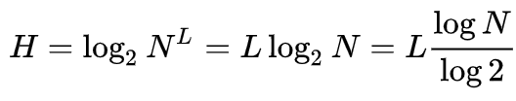
Important: Password
A common way to measure the quality of a password is bit strength
• Expresses the maximum number of attempts a random attacker needs to guess
("Brute force attack")
Bit strength depends on:
number of characters (or positions) in the password (L)
different characters possible in each position (N)
Bit strength (H)= lg2 (different characters possible in password=N) * number of characters in the password (L).
• NB! Practical device due to combinatorial explosion • 2 ^ bit strength = number of possible passwords that can be created

Slide 80
Important: Password - Example
Eg. PIN code uses n=10 different characters (0-9) in L=4 positions=> bit strength = lg2 (10) *
4 = 3.32 * 4 = 13.28
Number of different passwords we can generate = 10⁴ =N^{L}
How many bits (H) we need to express these passwords?
10⁴= 2^{H} , H=?
H= number of bits=bit strength
H=log₂ (10⁴)=4* log ₂10=4*3.32 = 13.28
Bit strength = lg2 (different characters possible in password=N) * number of characters in the password (=L).
L₃ | L₂ | L₁ | L₀
10 different characters | 10 different characters | 10 different characters | 10 different characters

Slide 81
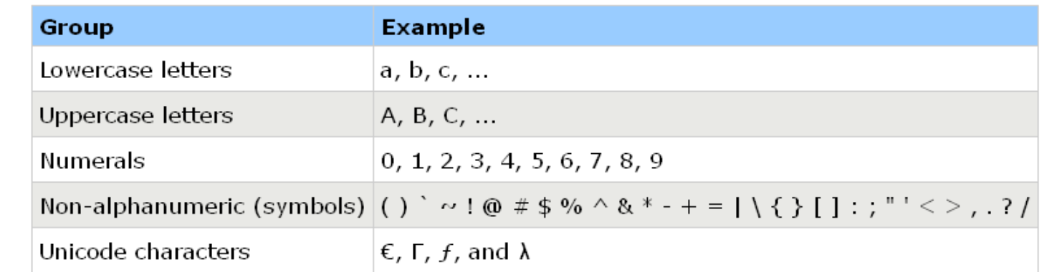
“Secure passwords”
• Recommended bit strength nowadays is about 80, i.e. more than twelve letters and characters!
• In addition, you should of course avoid everything that is related to your own, all common words (those found in dictionaries) etc.
Should contain characters from at least three of the groups below:

Slide 82
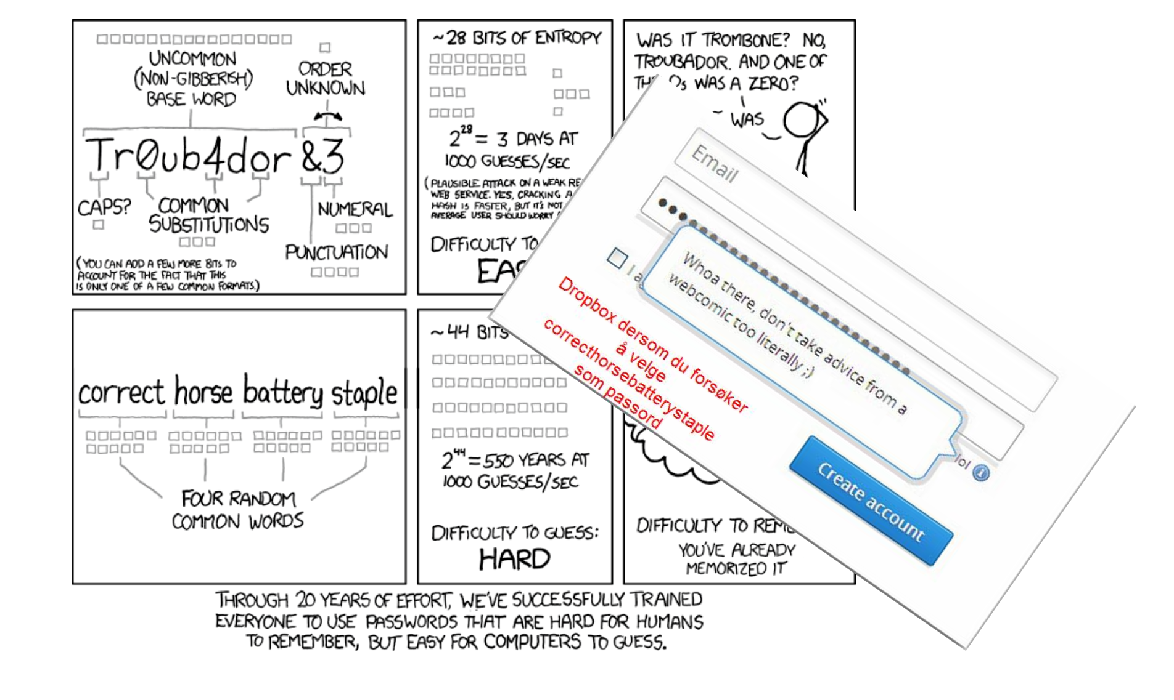
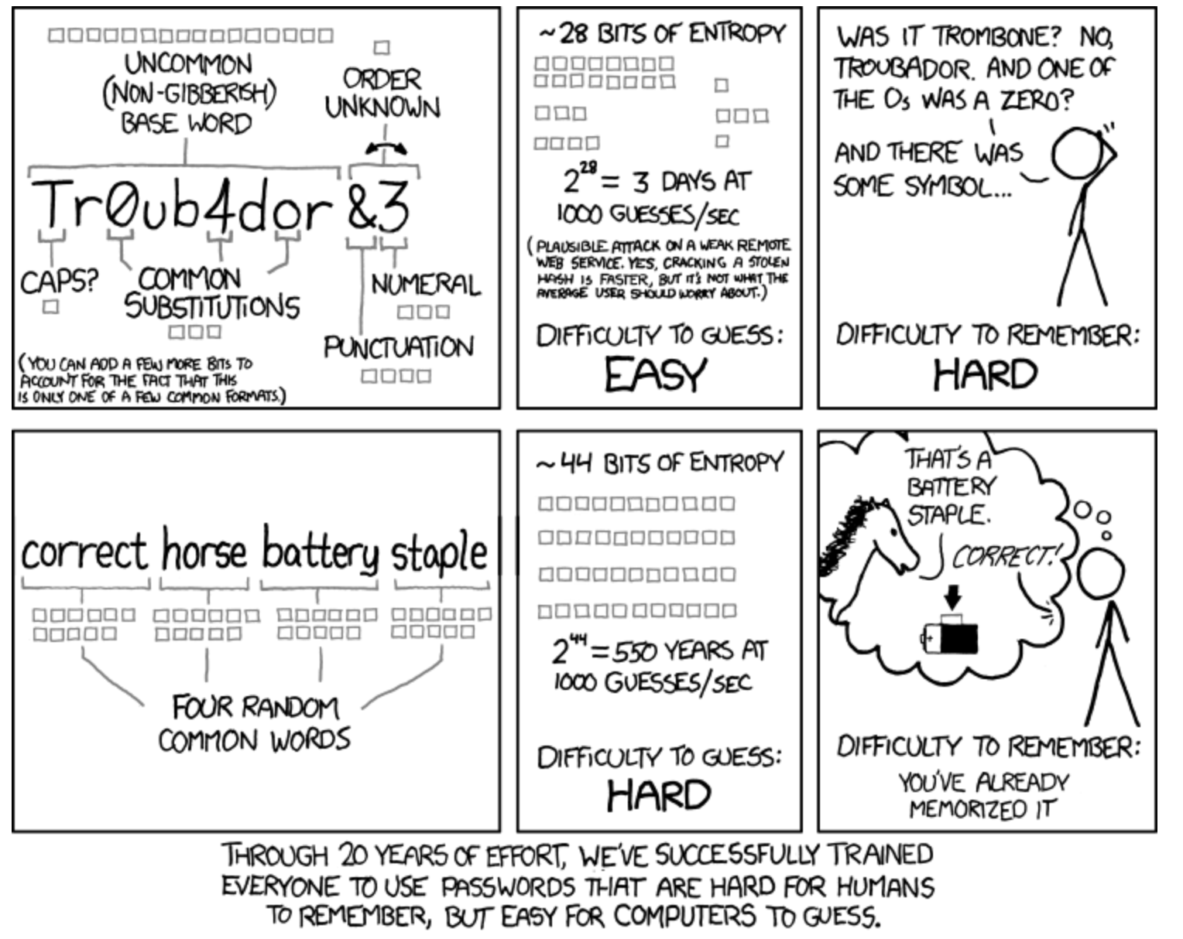
XKCD: Comments

Slide 83
Addition

Slide 84
Binary Addition
To add 2 bits, there are four possibilities
0 + 0 = 0
1 + 0 = 1
0 + 1 = 1
1 + 1 = 2 – we can’t write 2 in binary, but 2 is 10 in binary, so write a 0 and a carry bit 1
To compute anything (more than 2 single bits), we need to add binary numbers
This requires that we chain together carry digits (bits)
The carry out of one column goes to be added in the other column to its left

Slide 85
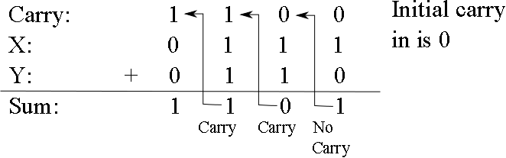
Binary Addition Continued
With 3 bits (the two bits plus the carry), we have 4 possibilities:
0 + 0 + 0 = 0
2 zeroes and 1 one = 1
2 ones and 1 zero = 2 (carry of 1, sum of 0
3 ones = 3 (carry of 1 and sum of 1)
Example:
Check your work, convert to decimal!

Slide 86
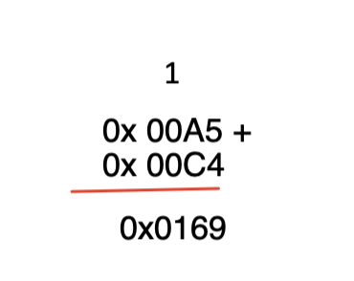
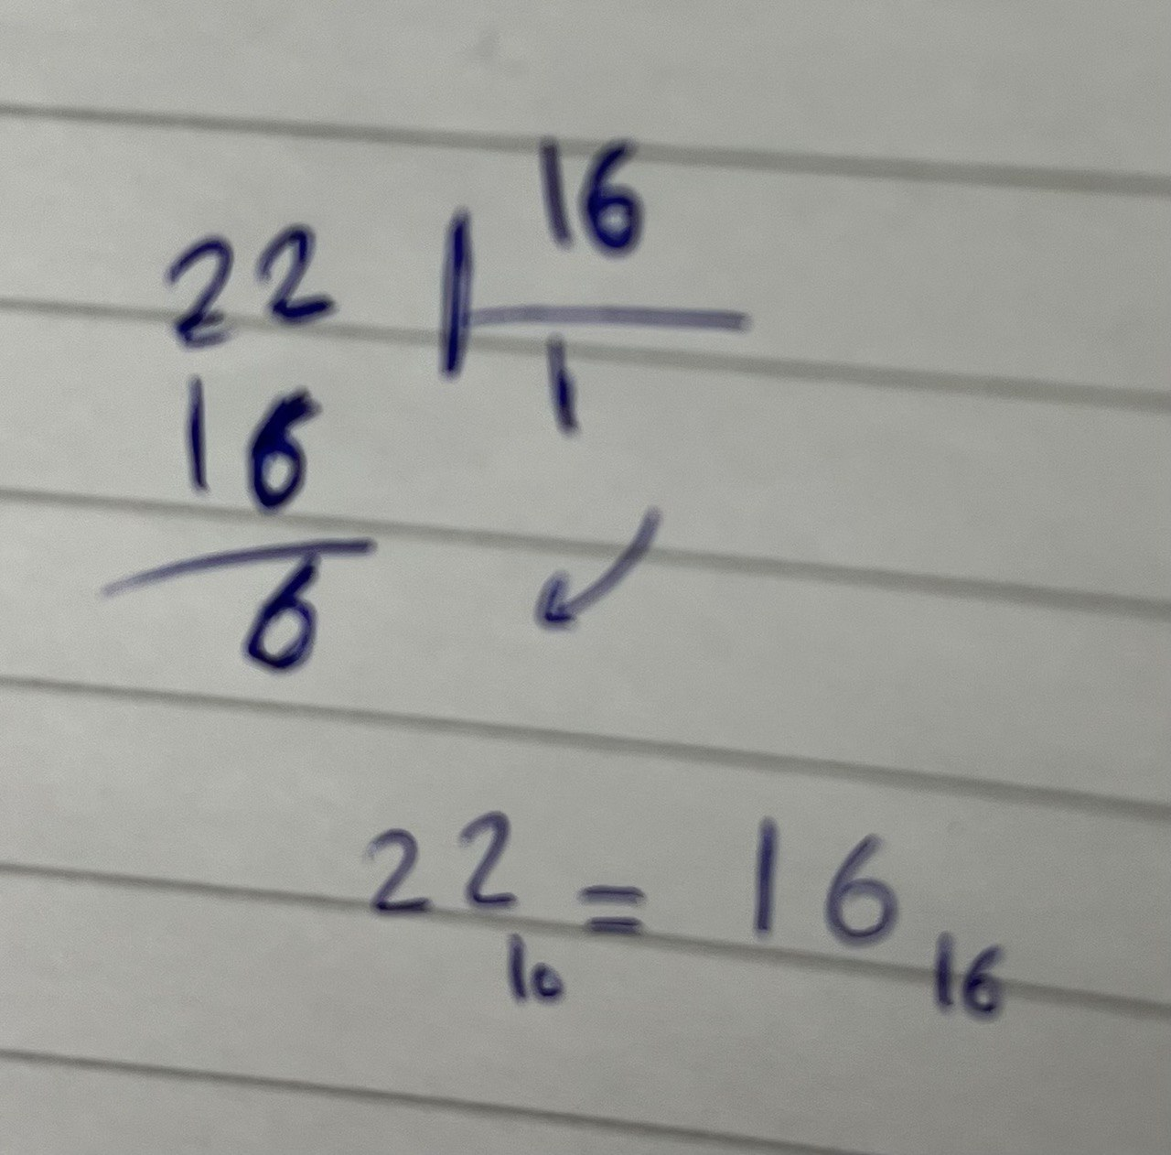
Hex Addition
With 3 digits (the two digits plus the carry)
Example:
16⁰ = 1
16¹ = 16
16² = 256
16³ = 4096
16⁴ = 65636
A=10
C=12
A+C= 22
22₁₀=?₁₆
Check your work, convert to decimal!

Slide 87
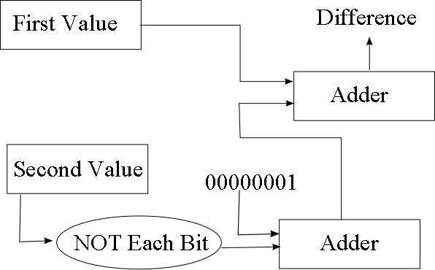
Subtraction
From math, A – B = A + (-B)
Store A and B in two’s complement
We can convert B into –B by
Flip all bits in B and adding 1
to flip all bits, apply NOT to each bit
to add 1, add the result to 00000001
We build a subtracter unit to perform this

Slide 88
Subtraction
Subtraction is always the same as adding the second complement
46
0010 1110
0010 1110
-37
-0010 0101
+1101 1011
9
1
0000 1001
Overflow,
We skip that !!
Due to 8 bit precision

Slide 89
For optional self-study
For those who want to learn some topics in more depth to better understand, here are some extra topics related to today's teaching, it must be expected some personal work to understand these topics.
There will be no questions on the exam from these, and this is therefore not considered to be part of the syllabus.

Slide 90
PRECISION
In computers, everything is stored either in RAM(«memory»),in registers («memory») on the CPU or other equipment.
These have addresses/names
Both in memory and on the CPU are smallest addressable device a Byte
It is not possible to save a bit, the minimum is 8!
Microsoft and others operates with the devices:
Byte: 8 bit
Word: 16 bit
Dword: 32 bit
Qword: 64 bit

Slide 91
Calculation operations - binary numbers
Remember!
Doubling is the
same as adding one
zero furtherest to the right…
Addition Multiplication
1
1
1
0000 1011
10 * 10
+ 0001 1010
00
10
0
0
0
1
1
0
1
0
0100

Slide 92
Negative numbers 2's complement
Inversion should not result in a difference of +0 and -0
Use 2s complement instead of 1s complement
0001 0011
1’s complement is the easier of the two processes as it really only involves taking a bit that is given and flipping its values.
1110 1100
1110 1101
2’s complement = 1’s complement + 1
0001
1110
1111
FLIP
+1
Note that both +0 and −0 return TRUE when tested for zero

Slide 93
2´s Complement
2´s Complement only works provided a certain precision, e.g. 8 bit
Then, 127 (0111 1111) becomes the largest number that exists, -128 (1000 0000) the smallest number that exists.
-128 «the silly number» because there is no positive version of it.
All other numbers can be changed by taking the second complement.

Slide 94
Network Addresses
Internet Protocol (IP) version 4 uses 32-bit addresses comprised of 4 octets
1 octet = 8 bits (0..255)
Each octet is separated by a period
The address 10.251.136.253
Stored as 00001010.11111011.10001000.11111101 in binary
Omit the periods when storing the address in the computer
The network address comprises two parts
The network number
The machine number on the network
The number of bits used for the network number differs depending upon the class of network
We might have a network address as the first 3 octets and the machine number as the last octet
The netmask is used to return either the network number or the machine number

Slide 95
Netmask Example
If our network address is the first 3 octets, our network netmask is 255.255.255.0
11111111.11111111.11111111.00000000
AND this to your IP address 10.251.136.253
11111111.11111111.11111111.00000000
AND 00001010.11111011.10001000.11111101
Gives 00001010.11111011.10001000.00000000
or 10.251.136.0 which is the network number
The machine number netmask is 0.0.0.255
What value would you get when ANDing 10.251.136.253 and 0.0.0.255?

Slide 96
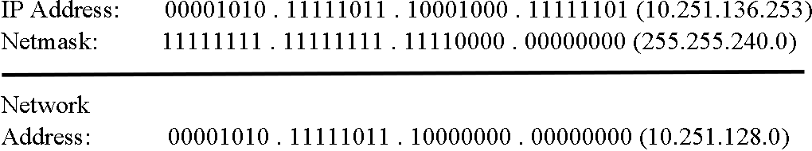
Another Example
In this case, the network address is the first 23 bits (not 24)
The netmask for the network is 255.255.240.0
Different networks use different netmasks we
will look at this in detail in chapter 12

Slide 97
Image Files
Images stored as sequences of pixels (picture elements)
row by row, each pixel is denoted by a value
A 1024x1024 pixel image will comprise 1024 individual dots in one row for 1024 rows (1M pixels)
This file is known as a bitmap
In a black and white bitmap, we can store whether a pixel is white or black with 1 bit
The 1024x1024 image takes 1Mbit (1 megabit)
A color image is stored using red, green and blue values
Each can be between 0 and 255 (8 bits)
So each pixel takes 3 bytes
The 1024x1024 image takes 3MBytes
JPG format discards some detail to reduce the image’s size to about 1MB using lossy compression, GIF format uses a standard palette of colors to reduce size from 3 bytes/pixel to 1 (lossless compression)

Slide 98
Parity
Errors arise when data is moved from one place to another (e.g., network communication, disk to memory)
We add a bit to a byte to encode error detection information
If we use even parity, then the number of 1 bits in the byte + extra bit should always be even
Byte = 001101001 (even number of 1s)
Parity bit = 0 (number of 1s remain even)
Byte = 11111011 (odd number of 1s)
Parity bit = 1 (number of 1s becomes 8, even)
If Byte + parity bit has odd number of 1s, then error
The single parity bit can detect an error but not correct it
If an error is detected, resend the byte + bit
Two errors are unlikely in 1 byte but if 2 arise, the parity bit will not detect it, so we might use more parity bits to detect multiple errors or correct an error

Slide 99
Big vs little Endian
In what order should bits and bytes be stored and transmitted?
For representations that require more than one byte, we have two options
Start with least significant byte (LSB at the lowest address)
Start with most significant byte (MSB at the lowest address).
In practice, this means that in UTF-16, for example, "A" has two different representations
Big Endian: 0x00 41 (IMB, Mac inntil Intel)
Little Endian: 0x41 00 (This was / is most common on Intel / AMD)
Misunderstanding will replace A with䄀
RAM-adresse | Big Endian | Little Endian
001A3BF7
001A3BF8 | 00 | 41
001A3BF9 | 41 | 00
001A3BFA

Slide 100
A float
Know how floating point numbers in a position number system work
Know the coding standard IEEE 754
Know the rounding issues associated with the use of floating point numbers

Slide 101
A floating-point number
How do you represent 5,625 binary?
As in any other position number system?
5.625 = 5 5/8 = 4 + 1 + 1/2 + 1/8 =
1*2² + 0*2¹ + 1*2⁰ + 1*2⁻¹ + 0*2⁻² + 1*2⁻³ = 101,101
This is exactly the equivalent of 103.57 being a notation for: 1*10² + 0*10¹ + 3*10⁰ + 5*10⁻¹ + 7*10⁻²
ie Converting to "comma numbers" is exactly the same as what we do in the decimal number system

Slide 102
Ex: Convert 0.6875 to bin
Start numbers | Double number | Result so far
0.6875 | 1.375 | .1
0.375 | 0.75 | .10
0.75 | 1.5 | .101
0.5 | 1.0 | .1011

Slide 103
IEEE 754 og x87
The IEEE 754 standard was developed by W. Kahn in conjunction with Intel's development of the 8087 math coprocessor
Used in most computers. Intel math processors (built into all CPUs after Pentium).
IEEE defines "single precision" (used by float in Java, 32 bit) and "double precision" (double in Java, 64 bit).
Intel's math "coprocessor" also has a third, higher precision: "extended precision" (80 bit, always used for intermediate calculation in the floating point unit (FPU)).
The latest version of the standard is IEEE 754-2008
Also allows 128 bit floating point numbers (34 decimal places) m.m.

Slide 104
IEEE single precision
31 | 30 | 23 | 22 | 0
s | exp |  | mantisse
Exactly up to about 7 decimal places.
s is a character bit. 0 for positive, 1 for negative.
exp (8 bit) er “biased” = real exponent + 7Fh. The values 00h and FFh have special meanings.
Mantissa is 23 bits - the first 23 bits after 1 in the significant end.

Slide 105
Ex: 5,8 i IEEE single precision?
5,8 = 101,1100 1100 1100 1100 1100 1100 …
With 23 numbers after the decimal point, we have: 1.0111 0011 0011 0011 0011 001 *2¹⁰
The sign bit is positive = 0.
Adjusted exponent is 0x7F + 0x02 = 0x81
We then get: 0100 0000 1011 1001 1001 1001 1001 1001 (sign and mantissa are underlined) or 40B99999h
Note: In C, 5.8 is represented as 40B9999A, because we dropped an LSB that was a 1. There is a better approach to 5.8

Slide 106
Ex: What is -0.5?
0.5₁₀ = 0.1₂
With 23 digits after the decimal point, we have 1.00000000000000000000000*2⁻¹
The sign bit is negative = 1.
The exponent is 7Fh + -1h = 7Eh
1011 1111 0000 0000 0000 0000 0000 0000 (BF000000h)

Slide 107
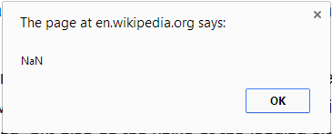
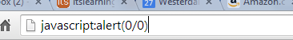
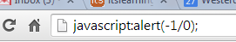
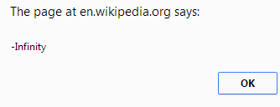
Not a Number
IEEE754 has its own codes for results that are not ordinary numbers (f111 1111 1kxxx …): NaN
This is available in several formats:
Depending on whether the code is to be used further or not(k=1 er «quiet NaN»)
Depending on the type of (mis) calculation that caused NaN
There are also separate codes for positive and negative infinity etc..

Slide 108
A float point numbers can be dangerous!!
An Ariadne rocket crashed due to a floating point error
For example. 10% = 0.1 in the decimal number system
Binary it is not possible to write 1/10 with a final number of digits, it will be 0,000110011001100110011001100…
If we convert back to decimal numbers, we can end up with 1/10=0,099999994
In IEEE754 you can specify the type of rounding to be done in which direction, but still always have to consider how many digits you can actually trust.

Slide 109
Code tables
BCD – Binary Coded Decimals
Each digit in the decimal number gets its 4-bit binary code
529₁₀ = 010100101001_{BCD}
Also has other variants where we use 8 bits per decimal digit, e.g.
529₁₀ = 0000101 00000010 00001001_{PBCD}
Intel / AMD processors still have their own instructions for BCD calculations
Similar to alphanumeric coding
All digits, letters (lower and upper case) and special characters are numbered
EBCDIC, ASCII, ISO, Unicode
M = 77_{ASCII} , : = 94_{EBCDIC}(5E₁₆)

Slide 110
Negative number: binary to decimal
There are two ways: First
When you are going to convert a binary number to decimal, and it is
stated that a double complement has been used on it, you will first look
at the most significant bit, and decide whether it is positive or negative. If
it is 0, the number is positive, and if it is 1, the number is negative. (Here
you must also make sure that you know the precision)
Example:
Say we have the number 1010 0101 with 8 bit precision on 2's
complement. Then we have to look at the number 8 places from the right,
and decide if the number is negative or positive. We see that the ‘Sign’
bit is a 1, which means that the number is negative. The first bit
corresponds to the number -128.
All the other bits can be considered positive, and thus we can add them
with -128 as follows:
1010 0101 = (-128) + 32 + 4 + 1 = -91
If the most significant bit had been 0, we would have got a completely
different result:
0010 0101 = (0) + 32 + 4 + 1 = 37
And if we were to run the math without a 2's complement, the result is
completely different:
1010 0101 = (128) + 32 + 4 + 1 = 165
Shortcut:
1111 1011=?₁₀
Find the first 10 from the left and keep the 1
1111 1011
-2³
Add the rest
-2³+2¹+2⁰
= -5
In the Lab

Slide 111
How many objects we have? (in what numbering system?)
Binary : we divide objects by 2
 | 2³ | 2² | 2¹ | 2⁰
 |  | 1 | 0 | 1
value | 8 | 4 | 2 | 1
5 /2 is 2 remainder 1
We will have 5 objects with size 4

Slide 112
How many objects we have? (in what numbering system?)
Binary : we divide objects by 2
 | 2³ | 2² | 2¹ | 2⁰
 |  | 1 | 0 | 1
value | 8 | 4 | 2 | 1
5 /2 is 2 remainder 1
We will have 5 objects with size 4
We will have 5 objects with size 4

Slide 113
How many objects we have? (in what numbering system?)
Binary : we divide objects by 2
 | 2³ | 2² | 2¹ | 2⁰
 |  | 1 | 0 | 1
5(obj with size 4) /2 is 2(objects with size 4) remainder 1 (objects with size 4)

